Slide 1
Introduction to Management of Technology
(MOT)
Jahid Hasan
Assistant Professor
Dept of IPE,SUST

Slide 2
Objectives
What is Technology?
What are the differences between science and technology?
Why need to study Technology?
What are the Applications of Technology?
How technology affect to the society and economy?
Technology Classification
What does the term Management of Technology mean?

Slide 3

???
How AirAsia, Jetstar can offer a fly with lower price in Airline industry?
How ANZ Royal Bank penetrate to Cambodia market?
Why Kodak failure in film competition?
How 5 stars hotel sale their service world wide?

Slide 4
???
How Cambodia government provide a visa to tourist via electronic system?
How ATM help bank operation?
How Internet help tour operation and travel agency to maximize their profit?
How IBM and Intel sell products online?
All answers will discuss through this course.

Slide 5
Introduction
Technological change is one of the most important sources of change in the economy.
The capacity for science and technology in some countries is not been adequately translated into innovative and dynamic business organization. The economy remains largely dependent on natural resources, traditional processing and manufacturing and, for the most part, on imported technologies.

Slide 6
Introduction (count-)
A sound scientific and technological base is essential to economic growth in a competitive international environment.
With the increasing impact of globalization on business, the scope for competition is no longer limited by national boundaries or by the definition of a particular industrial sector.

Slide 7
Introduction (count-)
Management of technology, innovation and information have also emerged as key requirements for success in the 21st century enterprise.
Thus, proper management of technological change, particularly at the productive enterprise level, has become the most important consideration for development.

Slide 8
Definition of Technology
All the knowledge, products, processes, tools, methods, and systems employed in the creation of goods or in providing services. [MOT, Tarek M. Khalil p.1]
The application of science and engineering to the development of machines and procedures in order to enhance or improve human conditions, or at least to improve human efficiency in some respect. [MS. IT Dictionary]
Technology is the technical means people use to improve their surroundings.

Slide 9
Differences between science and technology
Science is the study of why natural things happen the way they do.
Technology is the use of knowledge to turn resources into goods and services that society needs.
Science and technology affect all people.

Slide 10
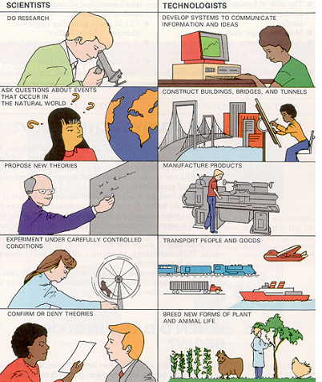

Slide 11
Why study technology?
People create technological devices and systems to satisfy basic needs and wants.
Technology is responsible for a great deal of the progress of the human race.
Technology is the tools to gain competitive advantage.

Slide 12
Application of Technology
Technology – linked to improvements in standards of living
Enhancement of economic prosperity for countries, industries and businesses depends upon the effective MOT
Technology creates wealth
Application of technology, not just its development, is a key to success in the competitive global economy.

Slide 13
Technology and Business
The goal of an organization is to achieve a set of objectives
Pool of knowledge available to society
Technology adds value to the assets of a company
Conversion of resources into goods and services

Slide 14
Classification of Technology
New technology
Emerging technology
High technology
Low technology
Medium technology
Appropriate technology

Slide 15
Management
Process of:
  Planning
  Organizing
  Coordination & Leading and
  Controlling

Slide 16
What is MOT ?
MOT is an interdisciplinary field that integrates science, engineering, and management knowledge and practice. [MOT, Tarek M. Khalil p.7]
Management of technology refers to the design and use of the means needed within organizations achieve economic and social objectives through technological innovation.

Slide 17
Management of Technology (MOT)
An interdisciplinary field
NATURAL SCIENCE
SOCIAL SCIENCE
ENGINEERING
MOT
INDUSTRIAL PRACTICE
BUSINESS THEORY

Slide 18
The roles of MOT
MOT field helps nation and firms to answer the following question:
How technologies is created?
How it can be exploited to create business opportunity?
How to integrated technology with business strategy?
How to use technology gain competitive advantage?
How can technology improve the flexibility of manufacturing and service systems?
When to enter and abandon technology?

Slide 19
Management of Technology : an entrepreneurial perspective.
Technology itself does not produce commercial results. It is its application that brings commercial benefits. Such application comes about due to the activities of “entrepreneurs”.
Any economy needs “ paper entrepreneurs” and “Product Entrepreneurs”
Paper entrepreneurs-Trained in law, finance , accountancy etc.. manipulate systems in novel ways:
  Establishing joint ventures, holding companies, finding tax shelters, investing in commodities; going public, etc.

Slide 20
Product entrepreneurs- engineers and scientists involved in production, researchers and designers, production managers, and businessman in produce goods and services people want.

Slide 21
Conclusion
Technology is clearly one of the dominant features of modern world.
Whether one supports or condemns, there is total consensus that managing technology effectively is critically important to the success and survival of individual companies and to national economic well-being and growth.
It is ironic that until recently the subject of management technology did not, in general, receive the kind of popular attention that is should have in business, government and management development programs.
The issue is how can we interpret “management of technology” in practical way.

